Slide 1
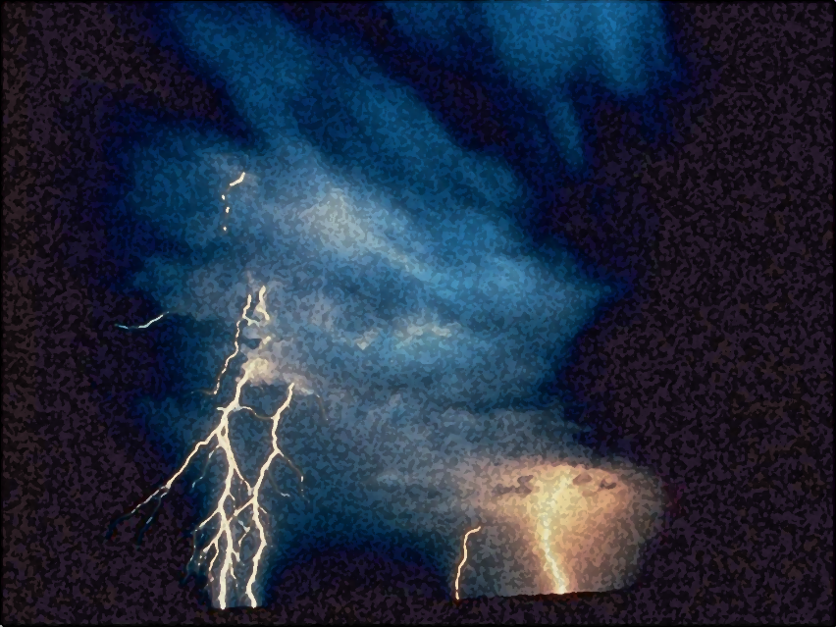

A Light out of Darkness
The Vision of Isaiah
Doom to Bloom

Slide 2


The Vision of Isaiah
Introduction:
The Present and
Future of God’s People
1-5
6:1-7
“what is” and “what will be”

Slide 3
The Vision of Isaiah
Introduction:
The Present and
Future of God’s People
1-5
6:1-7
From “sinner” to “servant”

Slide 4
The Vision of Isaiah
A Call to Servanthood
6
From “sinner” to “servant”
From “unclean” to “clean”
From “zero” to “greatness”

Slide 5
The Vision of Isaiah
A Call to Servanthood
6
How to become a useful, faithful and righteous servant of God?

Slide 6
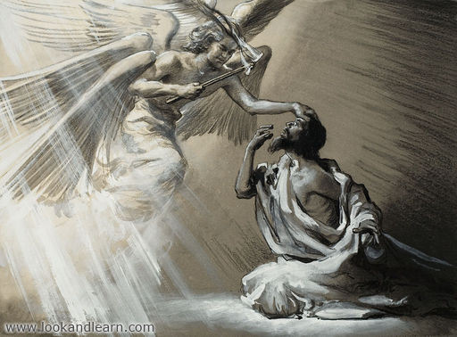
The Vision of Isaiah
Isaiah became a Servant of God
He said, “Here am I! Send me.”
Notes:
Chapter 6 tells us how Isaiah became a useful, faithful and righteous servant of God.

Slide 7
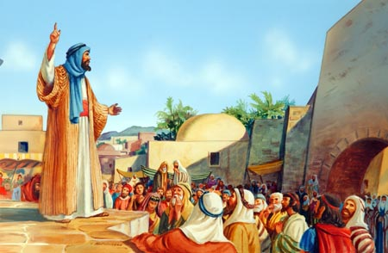
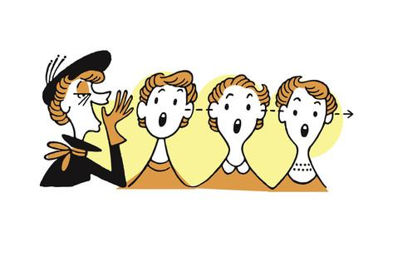
The Vision of Isaiah
Isaiah becomes a Servant of God
The Lord said, “Go tell the people”

Slide 8
The Vision of Isaiah
Isaiah becomes a Servant of God
He said, “How Long?”

Slide 9
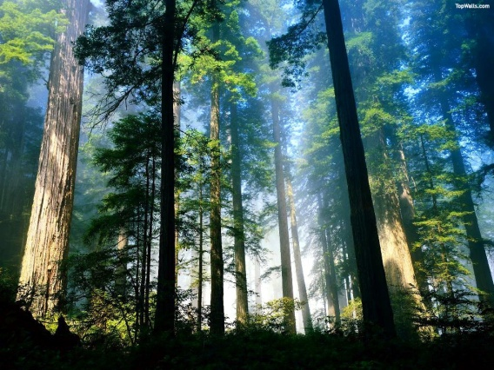
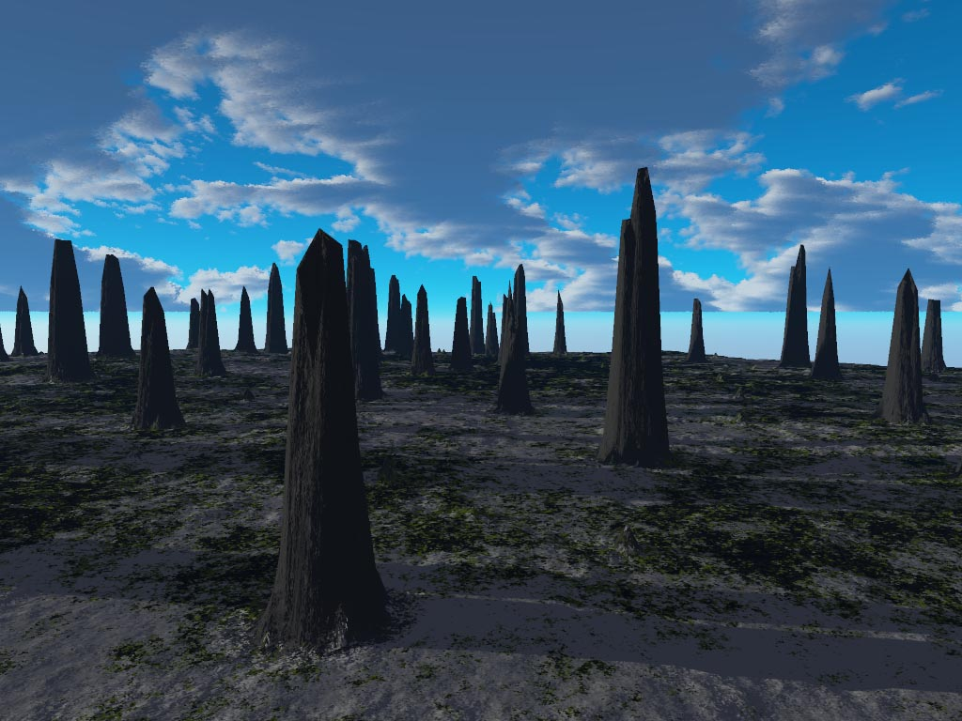
Notes:
"Until the cities are laid waste and without inhabitant, the houses are without a man, the land is utterly desolate, the LORD has removed men far away, and the forsaken places are many in the midst of the land. But yet a tenth will be in it, and will return and be for consuming, as a terebinth tree or as an oak, whose stump remains when it is cut down.” (Isa 6:11-13)

Slide 10
Notes:
“So the holy seed shall be its stump.“ (Isa 6:13) - Bloom out of Doom.

Slide 11
The Vision of Isaiah
In Whom Shall We Trust?
The Basis of Servanthood
7-39
Before anyone can become a Servant of God, one must first trust in the one whom they serve.

Slide 12
The Vision of Isaiah
In Whom Shall We Trust,
the Nations or the LORD?
Example of Distrust
7-12
Ahaz
God: Master of the Nations
13-35
Example of Trust
36-39
Hezekiah
Notes:
Chapter 7-12 gives us an historical example of distrust in the LORD. King Ahaz is given an opportunity to trust in the Lord but refuses to listen, a fulfillment of 6:9-10. The LORD offers him a sign, evidence that the LORD can be trusted. But He refuses to accept the sign. He refuses to trust in the LORD and His word. He instead decides to trust in Assyria and their many gods. Ahaz seeks the help of Tiglath-Pileser king of Assyria, but receives no help, but more trouble. He gets rid of one problem and gets a bigger one in return. The LORD now makes an appearance, prophesied in the sign of Immanuel, “God with us” promised judgment and destruction is upon them when the LORD appears in the form of an invading army. Total destruction is averted at that time, but God will be back.
On the other end we have another historical example, one of trusted in the LORD. King Hezekiah is faced with the same problem, an invading army, the Assyrian have invaded and surrounded him and the nation, with no hope of escape or deliverance. Hezekiah seeks the LORD for help and trusts in the Him and is saved, from destruction and death. The invading army is miraculously destroyed by the LORD Himself. Ahaz trusts Assyria and Israel is destroyed. Hezekiah trusts the LORD and Assyria is destroyed.
Between the two segments is a section whose theme is the God of Israel is the Lord of the nations.

Slide 13
The Vision of Isaiah
Example of Distrust
King Ahaz
The Nation of Israel
Doom/Destruction/Dispersion
Assyria/Babylon
Not Annihilation
“a remnant shall return”

Slide 14
The Vision of Isaiah
Example of Distrust
The Scribes and Pharisees
The Nation of Israel
Doom/Destruction/Dispersion
Rome
Not Annihilation
“a remnant shall return”

Slide 15
The Vision of Isaiah
Example of Distrust
Rebellious Israel
Peace Treat with Antichrist
Doom/Destruction/Dispersion
Revived Rome
Not Annihilation
“a remnant shall return”

Slide 16
The Vision of Isaiah
Example of Trust
King Hezekiah
The Remnant of Israel
Deliverance/Salvation
Assyrian Army Destroyed
Kingdom Established
Judgment Delayed

Slide 17
The Vision of Isaiah
Example of Trust
Peter and the Disciples
The Church
Deliverance/Salvation
“Overcomers”
“I will build My church”
Judgment Delayed

Slide 18
The Vision of Isaiah
Example of Trust
144,000
The Remnant of Israel
Deliverance/Salvation
Revived Rome/Antichrist Defeated
Not Annihilation
“a remnant shall return”

Slide 19
The Vision of Isaiah
Distrust
Ahaz/Jews
Nation of Israel
Judgment
No Annihilation
Trust
Hezekiah/Disciples
Church
Delay in Judgment
“Because of unbelief they were broken off, and you stand by faith.”
“a holy seed shall be its stump”

Slide 20
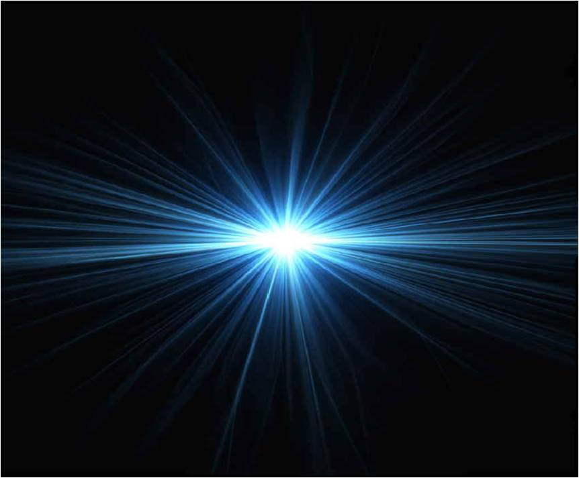
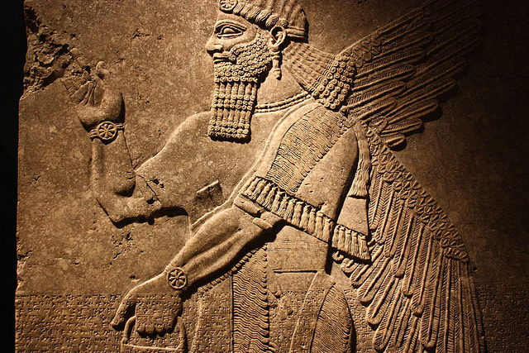
The Vision of Isaiah
God or Assyria?
An Example of Distrust
7-12
Notes:
Chapters 7-12 provide a historical introduction to the unit.
Read first two paragraphs on page 194 of Oswalt.

Slide 21
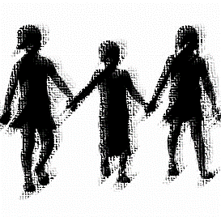
The Vision of Isaiah
Children,
Signs of God’s Presence
7:1 – 9:6

Slide 22
The Vision of Isaiah
Three Children
Shear-jashub
“a remnant shall return”
Immanuel - “God with us”
Maher-shalal-hash-baz
“quick to the spoil”
Notes:
All three of these children are children of Isaiah, [Actually there are only two children, Immanuel and Marher-shalal-hash-baz are one in the same, same child, by different name]. The use of these children names is which ties the segments together, Shear-jashub (7:3) Immanuel (7:14; 8:8) Maher-shalal-hash-baz (8:3) and the royal child in 9:5. “Over the machinations of the nations stands a group of children, helpless, and innocent. Yet in their innocence is a power which causes Isaiah to believe that right and justice are the great issues, not force and trickery. In light of this the thought moves from the folly distrust (7-8:22) to the reason to trust (8:23-9:6); strength is weakness; weakness is strength.
Shear-jashub – “a remnant shall return”; “a small number” – the name has a positive and negative sign to Kind Ahaz. It also meant “only a remnant”, not total annihilation.
Immanuel – “God with us” – can be used in a positive and negative way. The ten plagues of Egypt were used as a sign of God’s presence, a sign to the Egyptians of His judgement and a sign to Israel of her deliverance. Immanuel is positive in that it points to the delieverance from Syria and Israel, but it is also negative in that it shows that what overwhelms Judah’s enemies her well.
Maher-shalal-hash-baz – “quick to the spoil” – speaks of the swiftness of the judgment.

Slide 23
The Vision of Isaiah
Will You Believe?
“Shear-jashub”
“a remnant will return”
7:1 – 9

Slide 24
Will You Believe?
“And it was told to the house of David, saying, ‘Syria's forces are deployed in Ephraim. So his heart and the heart of his people were moved as the trees of the woods are moved with the wind.” (7:2)

Slide 25
Will You Believe?
“Because Syria, Ephraim, and the son of Remaliah have plotted evil against you, saying, ‘Let us go up against Judah and trouble it, and let us make a gap in its wall for ourselves, and set a king over them, the son of Tabel" – “ (7:5-6)

Slide 26
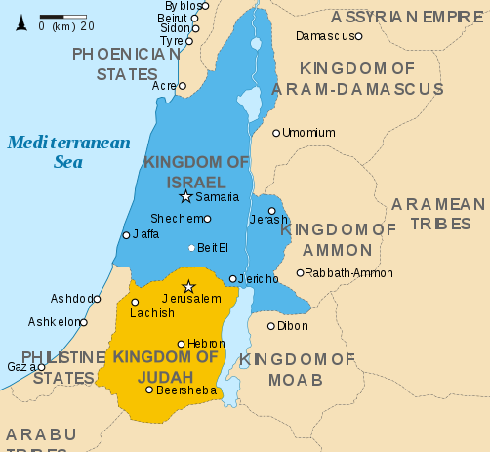
Will You Believe?
Notes:
The occasion is the Syro-Ephraimate threat.

Slide 27
Will You Believe?
“Then the LORD said to Isaiah, "Go out now to meet Ahaz, you and Shear-Jashub your son… and say to him: 'Take heed, and be quiet; do not fear" – “ (7:3-4)

Slide 28
Will You Believe?
“Why do the nations rage, and the people plot a vain thing? The kings of the earth set themselves, and the rulers take counsel together, against the LORD and against His Anointed, saying, ‘Let us break Their bonds in pieces and cast away Their cords from us.”

Slide 29
Will You Believe?
“He who sits in the heavens shall laugh; The LORD shall hold them in derision. Then He shall speak to them in His wrath, and distress them in His deep displeasure: ‘Yet I have set My King on My holy hill of Zion.” (Psalm 2:1-6)

Slide 30
Will You Believe?
“It shall not stand… Syria… and Ephraim will be broken, so that it will not be a people.” If you will not believe, surely you shall not be established.” (7:7-9)
“established” “aman” - protected
Notes:
“The final statement in this verse sums up the whole issue. Unless Ahaz comes to the point where he can believe in God’s sovereignty to the extent of entrusting himself and his nation to God, he is doomed to live in the shaky, panicky condition he now experiences (v. 2). He need not enter into the terribly risky covenant with Assyria, if he will but take firm hold of the covenant which God offers, Assyria will not over the security Ahaz wishes. Only through trusting in the present and ultimate veracity of God is any real security possible.”
Oswalt, p. 202.

Slide 31
Will You Believe?
“You don't believe me? If you want me to protect you, you must learn to believe what I say.” (7:9) [TLB]
“established” “aman” - protected

Slide 32
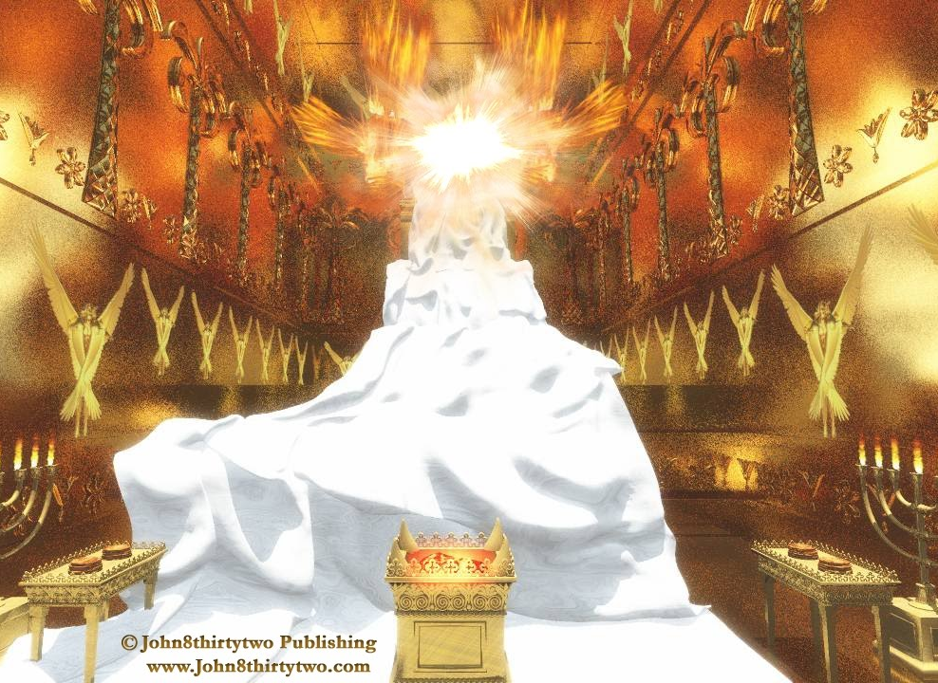
Will You Believe?
Ahaz has already established his faith in another, “the King of Assyria”, and has rejected and forsaken the LORD.

Slide 33
Will You Believe?
God is with Us
7:10 – 8:10
“Believe It or Not”

Slide 34
Will You Believe?
God is with Us
=
Immanuel
(7:10-17)
Maher-shalal-hash-baz (8:1-4)
=
Assyria
“like a razor”
(7:18-25)
Assyria
“like a flood”
(8:5-10)

Slide 35

God is with Us
The Sign of Immanuel
7:10 – 17

Slide 36
God is with Us
“Moreover the LORD spoke again to Ahaz, saying, ‘Ask a sign for yourself from the LORD your God; ask it either in the depth or in the height above.” (7:10-11)
“a sign” = “evidence”
Notes:
Why does the Lord offer King Ahaz for a sign, for evidence that His word can be trusted or affirmed? Especially since Ahaz has already established his faith in another. Isaiah challenges hi to seek evidence…” Evidence cannot create faith, it can only affirm it.
“Once King Ahaz abandon the conviction that God cared for him and is intimately involved with him, once abandon his perspective for his own, then suddenly decisions which are utterly foolish viewed from his perspective become intelligent and wise. When we cannot trust God, it suddenly makes good sense to trust our worst enemy. John Wesley said, “If a man will not believe God, he will believe anything.”
Isaiah’s message is to the unbelieving house of David, that what they have rejected as foolish – reliance/trust upon God’s care and presence - is ultimate wisdom, while their wisdom – that Assyria can be trusted to look out for Judah’s interests – is errant nonsense. “God is with Us” means that God’s word will be kept. The Syria and Ephraim attack will not succeed, but it also means that most of all Assyria is certainly not with them. This prophecy of Immanuel is both good and bad, joy and sorrow.” (Oswalt, 203-204)
“a sign” - A sign is something that points to, or represents, something larger or more important than itself. It is often linked with "wonders. The most important use of the word is in reference to the acts of God. They are given to strength one’s faith and are evidence of divine presence in that which it points.“
Nelson's Illustrated Bible Dictionary, Copyright (c) 1986, Thomas Nelson Publishers.

Slide 37
God is with Us
“And in that day I will set apart the land of Goshen, in which My people dwell, that no swarms of flies shall be there, in order that you may know that I am the LORD in the midst of the land.” (Exodus 8:22-23)
Notes:
God multiplied miraculous signs and wonders in Egypt as mighty acts of judgment upon the idolatrous Egyptians (Exodus 7:3). The plagues of Egypt were signs of God’s presence - a sign to the Egyptians of His judgment and a sign to Israel of her deliverance.

Slide 38
God is with Us
“When your days are fulfilled and you rest with your fathers, I will set up your seed after you... My mercy shall not depart from him, as I took it from Saul, whom I removed from before you. 16 And your house and your kingdom shall be established forever before you. Your throne shall be established forever” (2 Sam 7:12 )
Notes:
This is a sign that God will protect and save the nation from her enemies, and to preserve the Davidic line. This is what He must do! He must keep His Word!
“The LORD also declares to you that the LORD will make a house for you. "When your days are complete and you lie down with your fathers, I will raise up your descendant after you, who will come forth from you, and I will establish his kingdom. "He shall build a house for My name, and I will establish the throne of his kingdom forever. "I will be a father to him and he will be a son to Me; when he commits iniquity, I will correct him with the rod of men and the strokes of the sons of men, but My lovingkindness shall not depart from him, as I took it away from Saul, whom I removed from before you. "Your house and your kingdom shall endure before Me forever; your throne shall be established forever” (2 Sam 7:11-16)

Slide 39
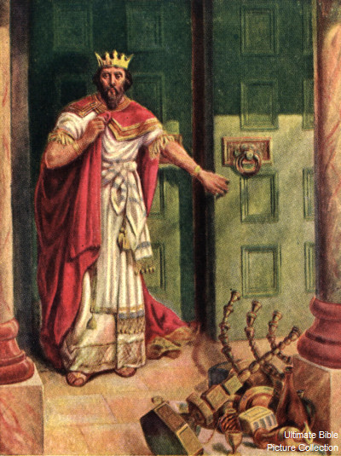
God is with Us
“But Ahaz said, ‘I will not ask, nor will I test the LORD!” (7:12)
Notes:
This is evidence of distrust in the Lord. He hears but he does not want to hear. “I have already made up my mind, do not confuse me with the facts!” Ahaz’s mind is already made up. He has concluded his only hope is an alliance with Assyria. It didn’t matter to him whether the Lord gave him a sign or not he wasn’t going to believe it anyway.
Ahaz sounds so pious. “I don’t need any evidence.” He possible makes an allusion to Duet. 6:16, where testing the Lord was forbidden. However a testing of God which grows from faith and out of faith, that testing God invites.

Slide 40
God is with Us
“Then some of the scribes and Pharisees answered, saying, "Teacher, we want to see a sign from You.” (Matt. 12:38)
Notes:
Why would they be seeking for a sign. They had plenty of signs or evidence presented before them.

Slide 41
God is with Us
“And all the multitudes were amazed and said, ‘Could this be the Son of David?’ Now when the Pharisees heard it they said, ‘This fellow does not cast out demons except by Beelzebub, the ruler of the demons.” (Matt. 12:23-24)
Notes:
After Jesus had healed a demon-possessed man who was deaf and mute, the people were amazed and asked, “Could the be the Son of David?” - that was not P.C. After the Pharisees saw this sign they concluded, NO He was not the Son of David but the Son of Satan. They had plenty of signs, wonders and evidence fully sufficient to reveal to them that Jesus was the Christ. But they refused to believe.

Slide 42
God is with Us
“Then the Pharisees and Sadducees came, and testing Him asked that He would show them a sign from heaven.” (Matt. 16:1-2)
Notes:
They were not seeking a sign so that they could believe in Him They sought a sign only so they could discredit Him. They fully expect He would not be able to perform a sign from heaven. Jesus responded no sign would be given them except the sign of Jonah, the resurrection. That is the only other sign/evidence needed for them to believe and be saved.

Slide 43
God is with Us
“Then he said, ‘Hear now, O house of David! Is it a small thing for you to weary men, but will you weary my God also?” (7:13)
Notes:
“The change from “your God” to “my God” is ominous. Ahaz has rejected the God who would have supported and established him. No longer can the prophet speak of “your God” now it is only “my God” who is evidently foreign to Ahaz. He has alienated himself and his house from God.” (p. 209)
“This the turning point in the fortunes of the house of David. That resolute act of unfaith signaled an abandonment of God by the dynasty and opened the door for its eventual destruction… The human house of David is finally without hope. The only hope is in God’s eventual miraculous provision. It is this setting that provides the Immanuel prophecy. Although Ahaz’s distrust of God has brought and end to the strictly human dynasty, God is still with David and Judah, as finally evidenced in the divine-human Messiah, Immanuel. This is why the prophecy occurs here and at this time.
The human house of David is without hope; and God’s patience has come to an end. Though it would linger on for some time the only hope is in God’s eventual miraculous provision.

Slide 44
God is with Us
“Therefore the Lord Himself will give you a sign: Behold, the virgin shall conceive and bear a Son, and shall call His name Immanuel.” (7:14)
Notes:
This passage has attracted immense interest. The greatest single focus of attraction has been the translation of “almah” or “parthenos” – virgin. Slightly less interest has been the attempt to identify the child “Immanuel”.

Slide 45
God is with Us
“a virgin” - `almah
“a young woman
of marriageable age”
“a sexually mature,
but unmarried, young woman”
Notes:
In Ahaz day, it only means that the young woman was “a virgin” at the time this prophecy was given not that she remained so at the child’s birth, as it was with Mary.
“…the prophet did not want to stress the virginity, neither did he wish to leave it aside.” (p. 210).

Slide 46
God is with Us
“a virgin” - `almah
Ahaz’s Wife – Hezekiah
Isaiah’s Second Wife
Isaiah’s First Wife
Mary
Notes:
In Ahaz day, it only means that the young woman was “a virgin” at the time this prophecy was given not that she remained so at the child’s birth, as it was with Mary.

Slide 47
God is with Us
“So all this was done that it might be fulfilled which was spoken by the Lord through the prophet, saying: ‘Behold, the virgin shall be with child, and bear a Son, and they shall call His name Immanuel," which is translated, ‘God with us’.” (Matt. 1:22-23)
Notes:
The primary focus is not the identity of the virgin, but the identity and the significance to the child. There will be more about the identity of the child born next week and the coming weeks.

Slide 48
God is with Us
A Short and Long Term Fulfillment
Immanuel
3 -70 AD
729 BC
Notes:
The sign of Immanuel was two-fold: the birth of the child was to point to and to accompany the withdrawal of enemy forces. Many scholars have opted for a “double-fulfillment”. The first fulfillment was to occur during Ahaz’s time, and then applied later to Christ.
“So Ahaz’s sign must be rooted in its own time to have significance for that time, but it also just extend beyond that time and into a much more universal mode if its radical truth is to be any more than a virgin hope. (p. 211)
The disappearance of Syria/Ephraim was evidence that God was with them. But when Assyria appears was God still with them?
A child born in Ahaz’s time is not evidence that God is with us in all times. But if a child was born of a virgin conceived by God’s Spirit this would be a sign that God’s presence is with us all, for all time.

Slide 49
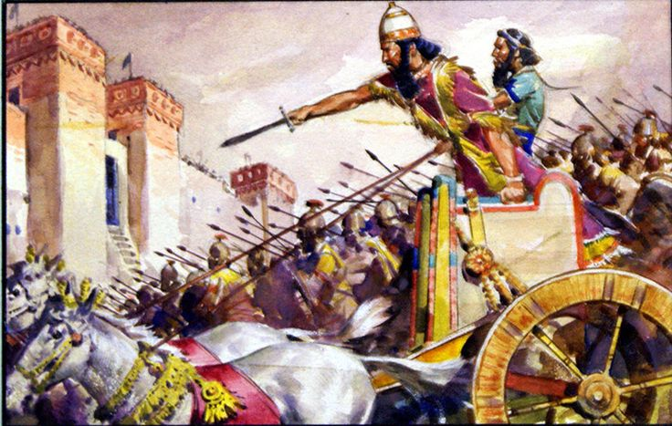
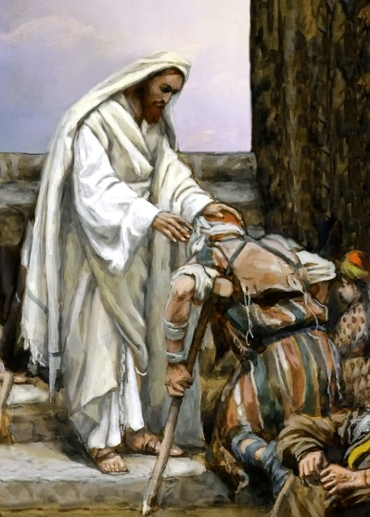
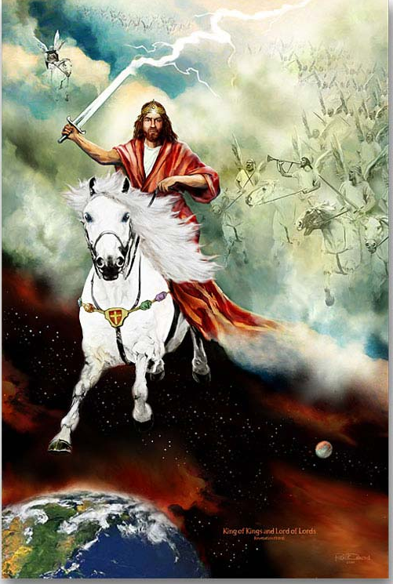
God is with Us
A Positive and Negative Fulfillment
Deliverance
and
Destruction
A Blessing
and
A Curse
Notes:
“The presence of a transcendent and holy God with us may well mean weal and woe together. To the extent that we are dependent upon Him, his presence results in blessing; but to the extent that we refuse to depend upon him, his presence is an embarrassment and a curse. Both realities are implicit in his presence” (Oswalt, p. 209)

Slide 50
God is with Us
“Curds and honey He shall eat, that He may know to refuse the evil and choose the good. For before the Child shall know to refuse the evil and choose the good, the land that you dread will be forsaken by both her kings.” (7:15-16)
Notes:
The good news is that Assyria will depopulate Syria and Ephraim. The bad news is that Assyria will depopulate Judah.
The abundance of these foods is the result of depopulation.
By the time the child will reach the age of accountability, both of the threatening powers will have ceased to exist.

Slide 51
God is with Us
“The LORD will bring on you, on your people, and on your father's house such days as have never come since the day that Ephraim separated from Judah, the king of Assyria.” (7:17) [NASB]
Notes:
By Isaiah holds back the name, “the king of Assyria” to the end has its impact is doubled. This is the final blow of Ahaz’s self-sufficiency.
His plans have backfired. So very bad days are coming, and it is the awful thunder of war-chariots. “Whatever a man trust in place of God will one day turn to devour him.” (p. 214)

Slide 52
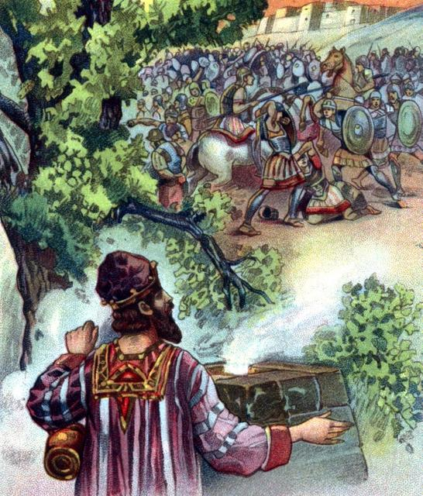
God is with Us
The Razor of Assyria
7:18-25

Slide 53
God is with Us
“And it shall come to pass in that day that the LORD will whistle for the fly that is in the farthest part of the rivers of Egypt, and for the bee that is in the land of Assyria. They will come, and all of them will rest in the desolate valleys and in the clefts of the rocks, and on all thorns and in all pastures.” (7:18-19)

Slide 54
God is with Us
“In the same day the Lord will shave with a hired razor, with those from beyond the River, with the king of Assyria, the head and the hair of the legs, and will also remove the beard.” (7:20)

Slide 55
God is with Us
“It shall be in that day that a man will keep alive a young cow and two sheep; So it shall be, from the abundance of milk they give, that he will eat curds; For curds and honey everyone will eat who is left in the land.” (7:21-22)
Notes:
The land will revert from a crop growing region to a herding region in which there will be so few people that a minimum of animals will produce more than enough food.

Slide 56
God is with Us
“It shall happen in that day, that wherever there could be a thousand vines worth a thousand shekels of silver, it will be for briers and thorns. With arrows and bows men will come there, because all the land will become briers and thorns.” (7:23-24)
Notes:
The effects of depopulation and a land that is no longer tilled, the land will revert to a wilderness, where wild animals will reestablish themselves in the thickets. Vineyard will be turned into briars and thorn bushes and farm land will be turned into hunting grounds.

Slide 57
God is with Us
“And to any hill which could be dug with the hoe, you will not go there for fear of briers and thorns; But it will become a range for oxen and a place for sheep to roam.” (7:25)

Slide 58
The Vision of Isaiah
Notes:
Trust the Lord and believe His signs/evidence that His Word is true, and you will be established on the earth. Distrust the LORD and refuse the evidence and perish from the earth.

